Slide 1
HASMUKH GOSWAMI COLLEGE OF ENGINEERING
BRANCH :- ELECTRONICS & COMMUNICATION

Slide 2
Topics
SUBJECT : ELEMENTS OF ELECTRICAL
ENGNEERING
Types Of Cable
Types Of Wiring
Types Of Switches
Industrialing & domestic wiring

Slide 3
Types of cables
Cables Are Classified Mainly According To :
(1) Conductor Used (2) Types Of Insulation
(3) Voltage Grading (4) Number Of Cores.
The Various Conducting As Well As Insulating Materials Which Can Be Used Have Been Mentioned Earlier.
The Cables Are Divided Into Two Groups Based On The Voltage Grading : (1) 250/440 V Cables And (2) 650/1100 V Cables.

Slide 4
Depending upon the number of stands, cables are classified as two core, three core, three and a half core and four core cables or even more.
In three and half core cable as well as four core cable there are three stands of equal cross sectional area for R, Y and B phases respectively.
Multi strand cables are more durable. They are more flexible and hence are easier to handle.

Slide 5
As compared to single core cables, multi core cables have more surface area and therefore their cooling or heat radiating capacity.

Slide 6
Types of wiring
Wooden casing and capping wiring
CTS (Cabtyre Sheathed Wire)
Cleat wiring
Lead sheathed wire
Conduit wiring

Slide 7
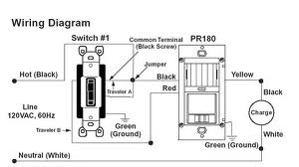

Slide 8
(1) Wooden casing and capping wiring :-
Such wiring is carried out in grooves of wooden casing.
The casing is made of seasoned teak wood and is used in rectangular blocks having a number of grooves equal to the number of wires.

Slide 9
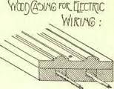
Such type of wiring is used for voltage upto 250 V.
It is necessary to safeguard it against dampness and risk of fire.

Slide 10
(2) CTS (Cabtyre Sheathed Wire) :-
Such a type of wiring used in residences uses cabtyre sheated wire as the conductor.
These wires are run on teak wood battens which in turn are fixed on the walls or, ceiling by means of screws and wooden plugs.

Slide 11
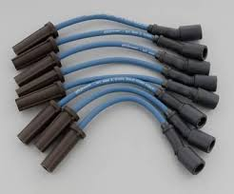
They have a better appearance as compared to the wooden casing and capping wiring.

Slide 12
(3) Cleat wiring :-
Such type of wiring is used for taking a temporary connection.
Here vulcanized Indian rubber or polyvinyl chloride insulated wires are used as conductors.

Slide 13
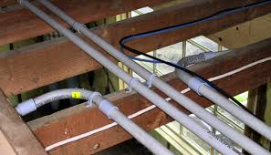
There are grooves provided on the cleat base to accommodate the wires.

Slide 14
(4) Lead sheathed wire :-
The conductors used here are insulated with vulcanized indian rubber.
Then, an outer sheath made of lead – aluminium alloy containing 95% lead and 5% aluminium is used to cover the insulated conductor.

Slide 15
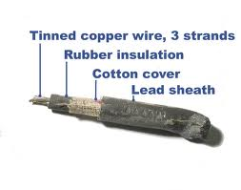
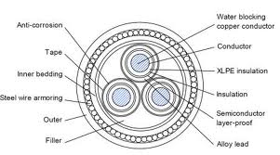

Slide 16
This sheath protects the wiring from mechanical injury, atmospheric action and dampness.

Slide 17
(5) Conduit wiring :-
The conductors used here are insulated with polyvinyl or vulcanized indian rubber.
They are then carried in mild steel tubes commonly called conduits.
They are concealed inside the plaster of the wall and hence the appearance of the house or the building remains unaffected.

Slide 18
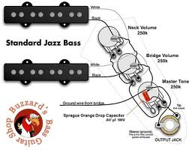
It provides protection against fire hazards, mechanical damage, dampness and shocks.

Slide 19
Types of switch
Toggle switch
Push button switch

Slide 20
(1) Toggle switch :-
It has a projecting arm which moves through a small are thus causing the circuit contacts to either open or close.
From fig. , it can be seen that as the arm moves from the OFF to the ON position through the arc it closes the contacts of the electric circuit.

Slide 21
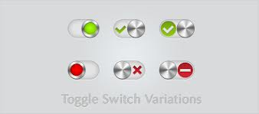
Such simple toggle switches are used in most of the houses.More complex toggle switches are also used which may have more than two positions and may open and close more than one circuit simultaneously.

Slide 22
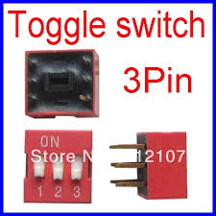
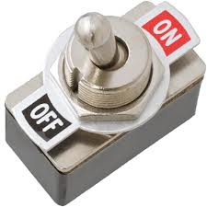
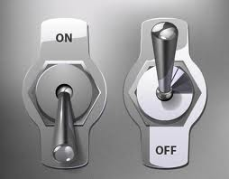
Types of Toggle Switches :

Slide 23
(2) Push button switch :- :
Such a switch closes the circuit when pressed and when released, comes back to its original position.
These are commonly used in the doorbell switches, dimmer switches on the automobile head lights etc.

Slide 24
INDUSTRIAL WIRING
The wiring in the industries and factories should be done according to the Indian electricity rules.

Slide 25
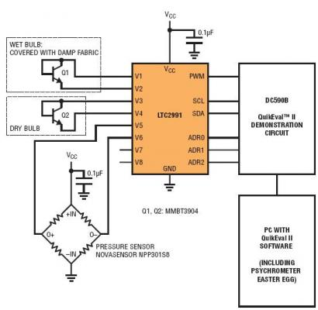

Slide 26
Factory / Godown lighting circuit
From the wiring diagram , it can be seen that, there are two way switches on the switch boards SB_{2,}SB₃,&SB_{4.}
While moving in the godown he can put on lamp L₁ by operating the first two-way switch board SB₁.
When he reaches the switch board SB_{2,}he can operate the first two-way switch on SB₂.

Slide 27
Thus lamp L₂ will be connected between the phase & the neutral & will become ON. L₁will become OFF.
Again when he reaches the switch board SB₃, he can operate the first switch on SB₃ thus putting OFF L₂ & putting on L₃ & soon.

Slide 28
Thank You

